Slide 1

Cyclistic: How Does a Bike-Share Navigate Speedy Success?
Author: Oluwatunmise Ayinde
May 2022

Slide 2
Background
In 2016, Cyclistic launched a successful bike-share offering. Since then, the program has grown to a fleet of 5,824 bicycles that are geotracked and locked into a network of 692 stations across Chicago. The bikes can be unlocked from one station and returned to any other station in the system anytime.
There are two types of cyclists, those who purchase casual tickets and those purchase annual memberships. The marketing team believes that maximizing the number of annual members will be key to future growth. Rather than creating a marketing campaign that targets all-new-customers, there is a very good chance to convert casual riders into members.

Slide 3
Problem
What is the most effective marketing strategy of converting Cyclistic’s casual riders to annual memberships?
How do annual members and casual riders use Cyclistic’s bikes differently?

Slide 4
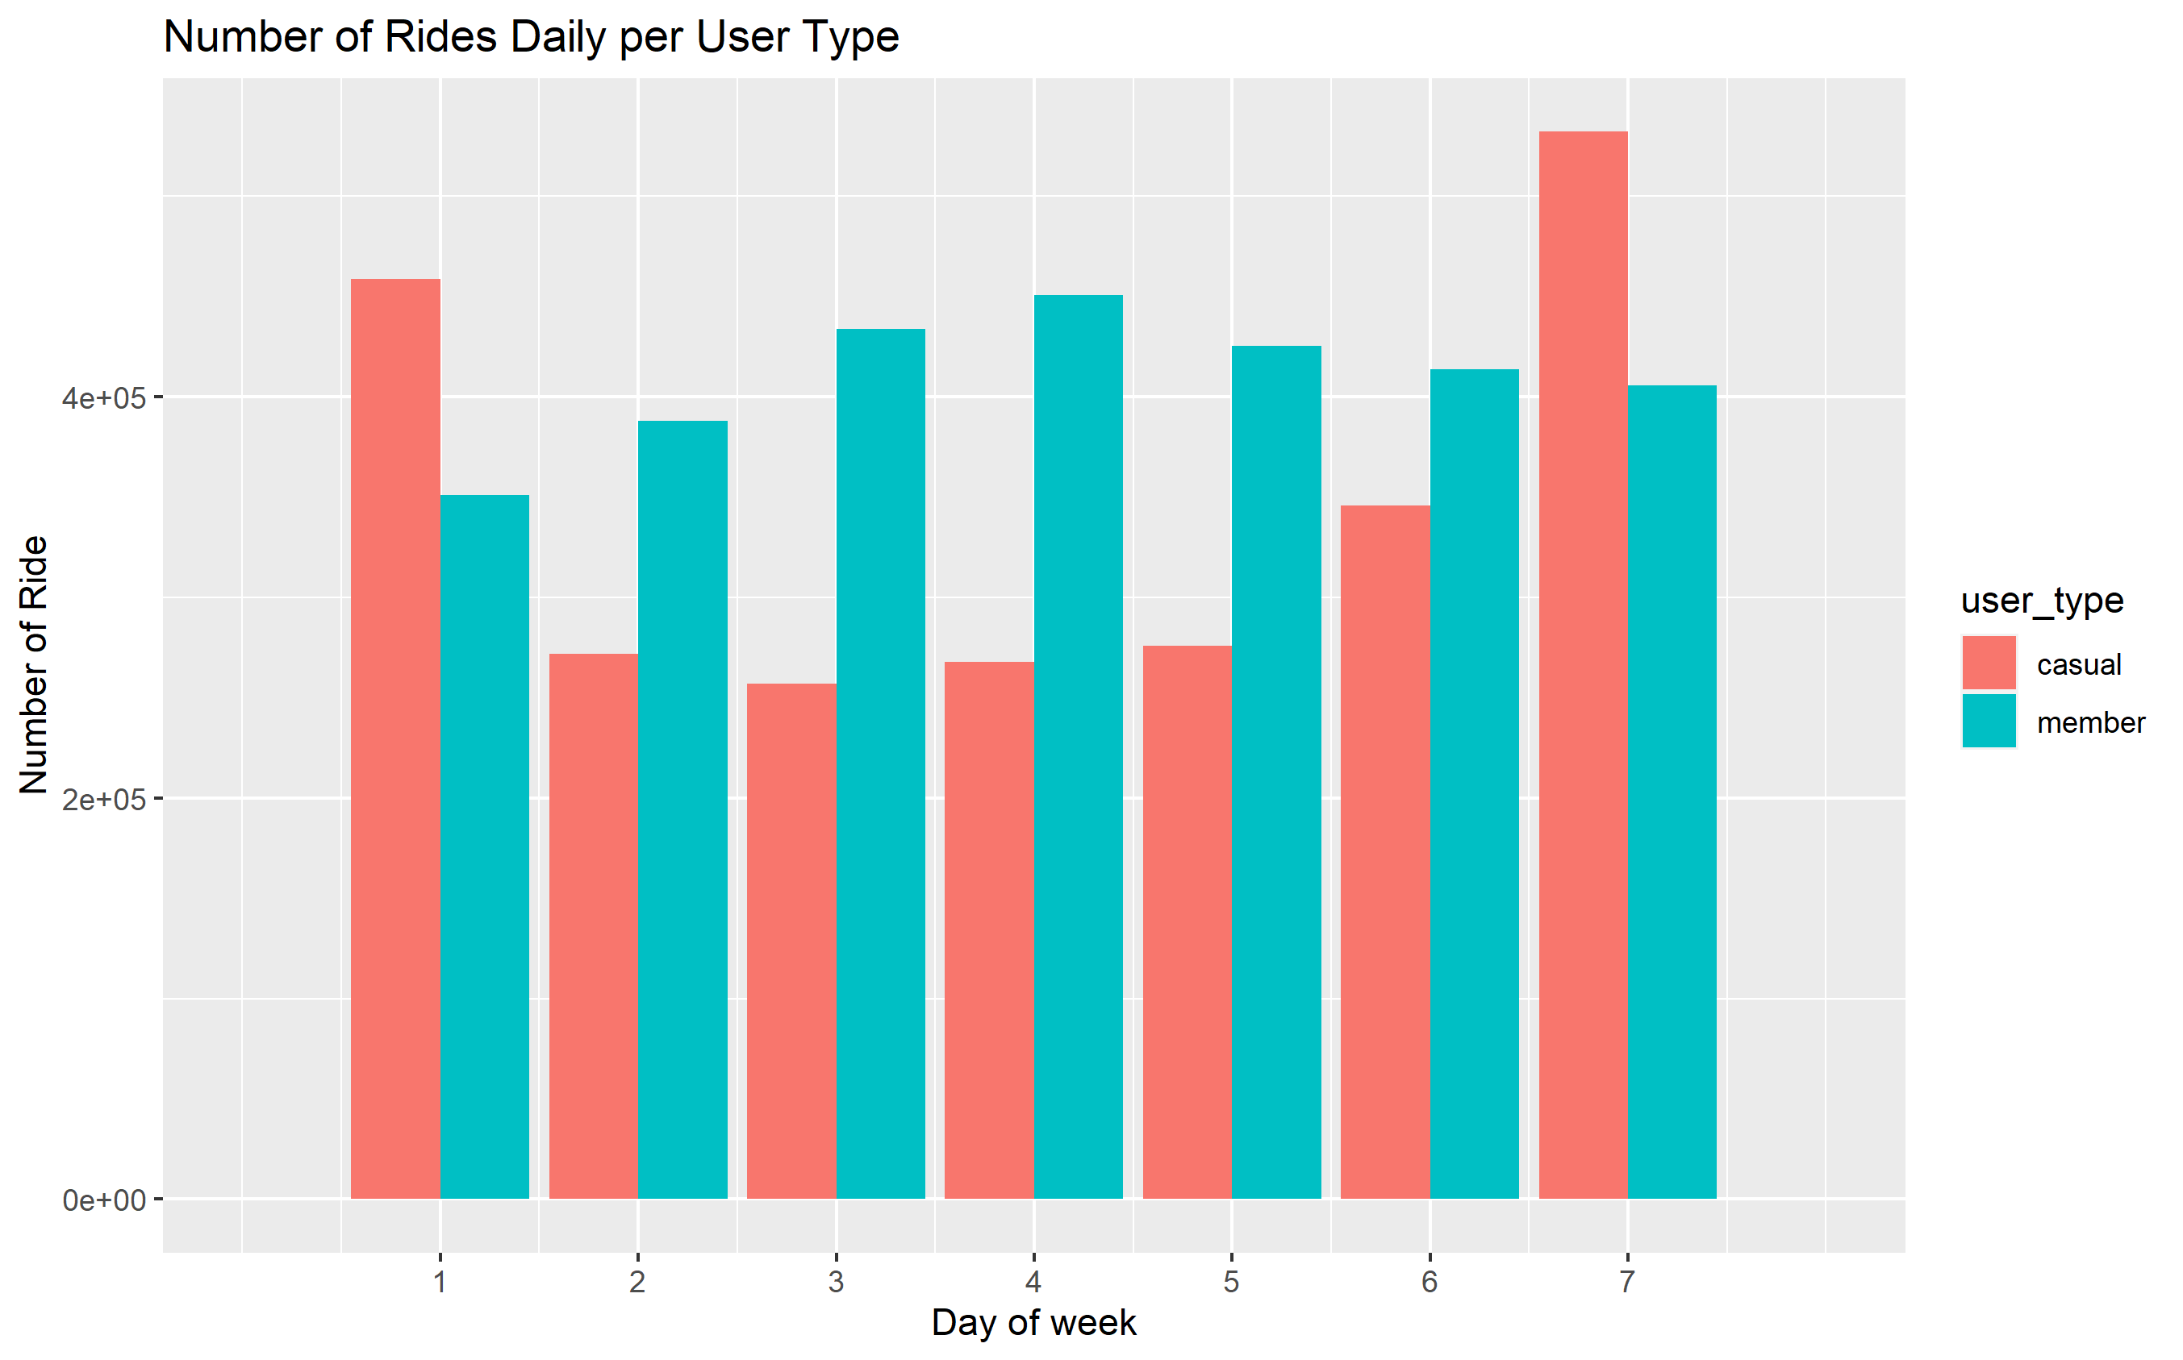
What did the data tell us: Rides per week
Sunday thru Saturday (1-7)

Slide 5
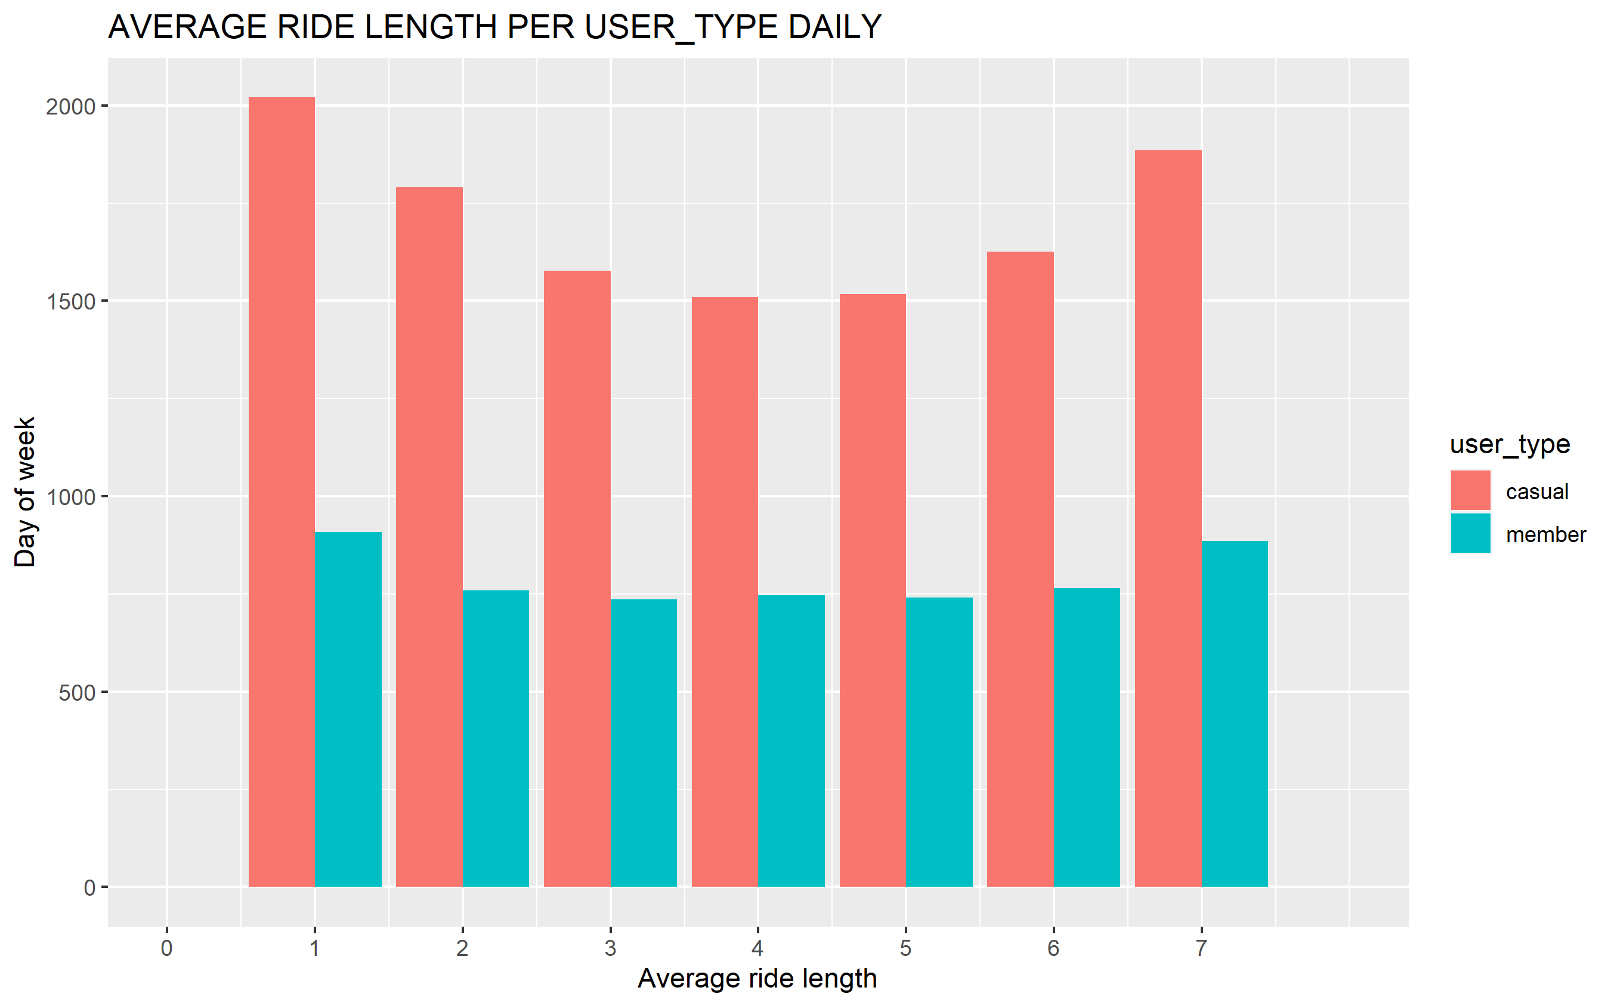
What did the data tell us: AVERAGE RIDE LENGTH PER USER_TYPE DAILY
Sunday thru Saturday (1-7)

Slide 6
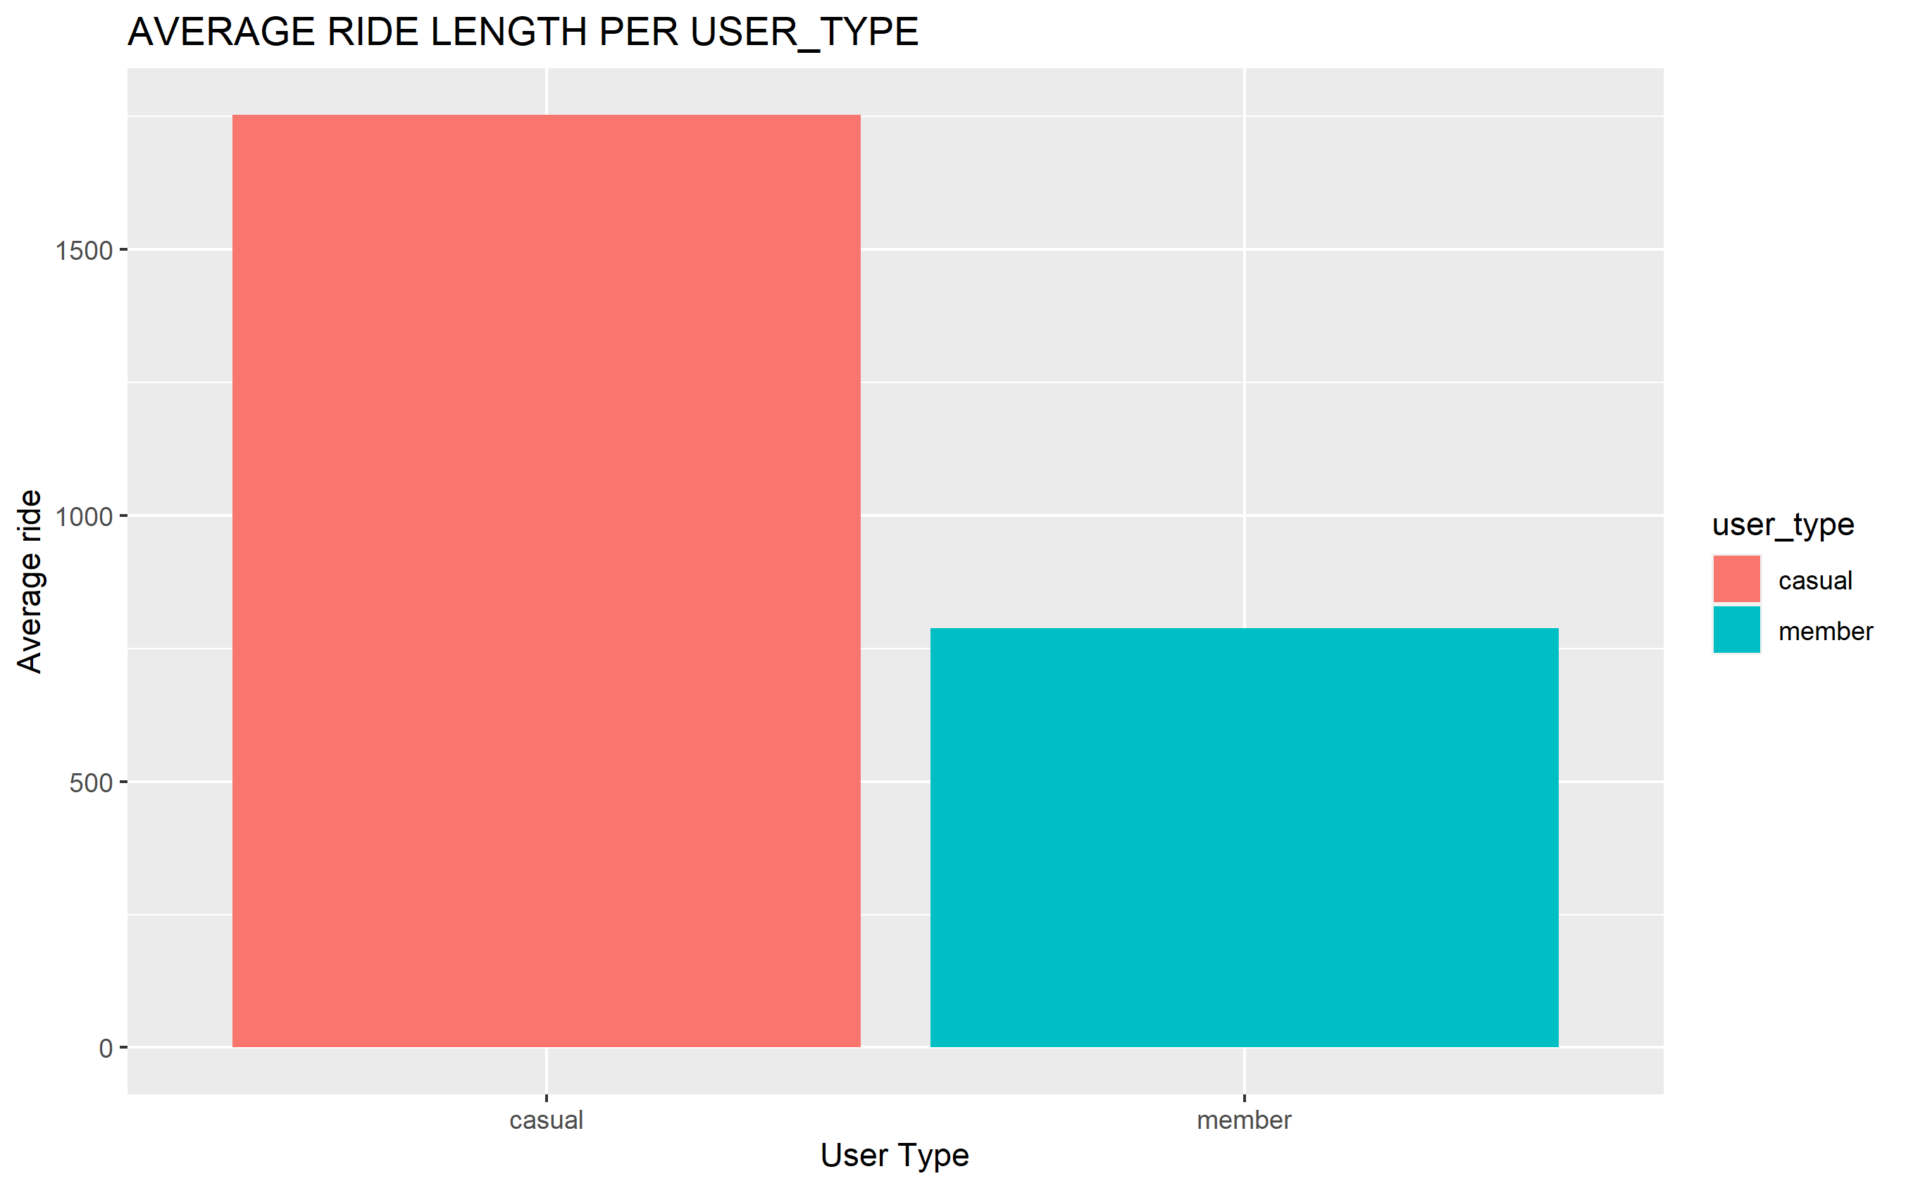
What did the data tell us: AVERAGE RIDE LENGTH PER USER_TYPE

Slide 7
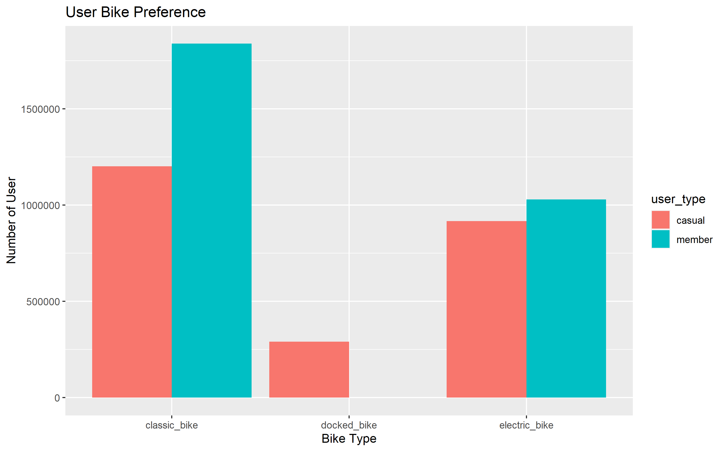
What did the data tell us: User Bike Preference

Slide 8
Key Findings: Summary
Casual demographic spend on average a lot longer time per ride than the long-term members.
Causal riders peak more during the weekends while Long-term members peak more during the week.
The classic bike is most preferred type of bike and casual riders tend to stick with that.

Slide 9
Recommendations
Introducing plans that will be more attractive to casual users during the weekdays
Membership rates for riders throughout the week
Discounts per average ride length

Slide 10
Additional Information
Dataset doesn’t provide information on gender type that uses the bike has this would be necessary to determine marketing strategy for annual memberships.
Data doesn’t provide information on pricing structure.
Data doesn’t provide information on closeness of bike station to users.

Slide 11
Sources
Data source
Jan 2021 – Dec 2021 Bike trips- Divvy

